Slide 2

Depression diagnosis via social media posts
- Team 13 -

Slide 3
TEAM MEMBERS
Nguyễn Trọng Minh (20235976)
Nguyễn Lê Hưng (20235942)
Nguyễn Anh Đức (20235914)
Phạm Xuân Tuấn (20236010)
Đồng Đại Huy (20235945)

Slide 4
DEFINITION & PURPOSE
Definition: Binary classification — depression-related (1) vs normal (0) from title+body + metadata.
Mechanism: Stage 1 MentalRoBERTa+LoRA outputs p_text; Stage 2 LightGBM on p_text + 38 metadata (39 inputs).
Purpose: Subreddit-blind screening for real-world social posts (not just Reddit).

Slide 5
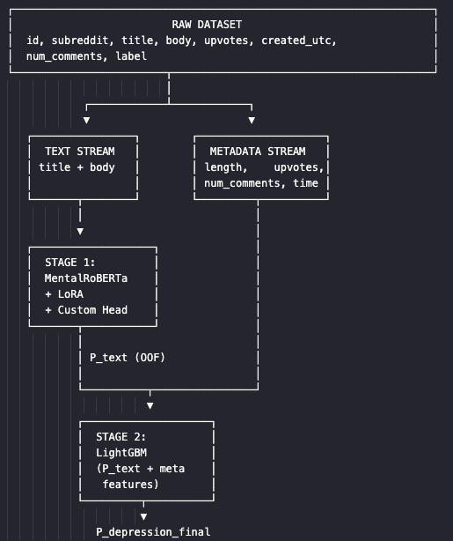
Why not a single model?
Text and metadata provide complementary signals
Modular design — debug each stage independently
Enables ablation: text-only vs meta-only vs full ensemble

Slide 6
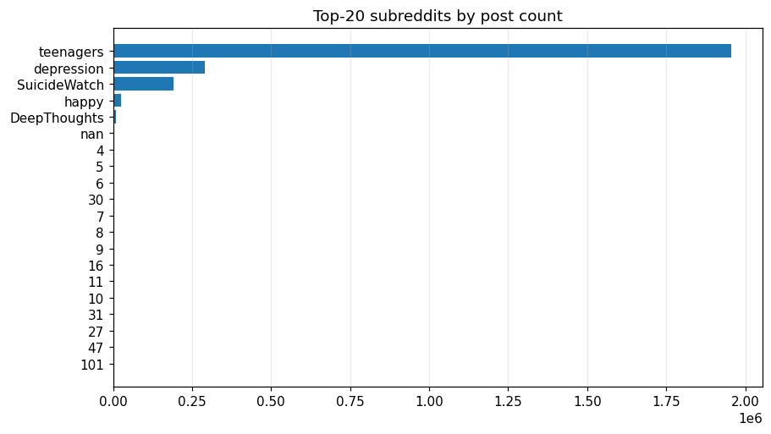
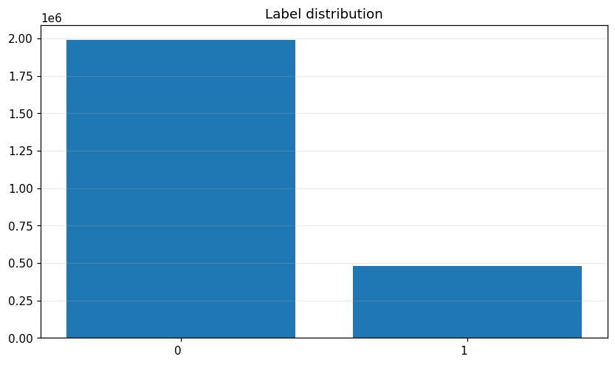
DATASET OVERVIEW
2,470,778 Reddit posts (Jan 2008 – Dec 2022)
8 columns: id, subreddit, title, body, upvotes, created_utc, num_comments, label
Task: binary classification (0 = normal, 1 = depression-related)

Slide 7
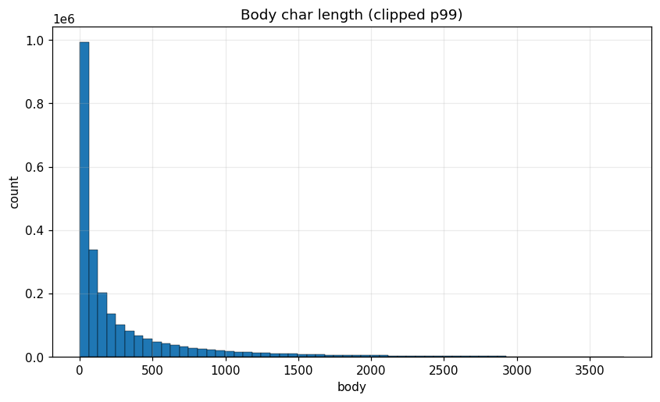
DATA QUALITY ISSUES & PREPROCESSING
Missing & invalid text
18.7% posts: body empty / [removed] / [deleted]
4.6% missing num_comments
Title missing: negligible (0.0009%)
Duplicates & noise
Body duplicates (≥40 chars): 0.35% (8,526 rows)
id duplicates: negligible (3 rows)
Extreme distributions
Body length highly skewed: median 103 chars, max 65,781
Upvotes skewness 37.4, comments 69.8
Language
96.1% English (langdetect, n=50K sample)
~3.9% other languages / noise–

Slide 8
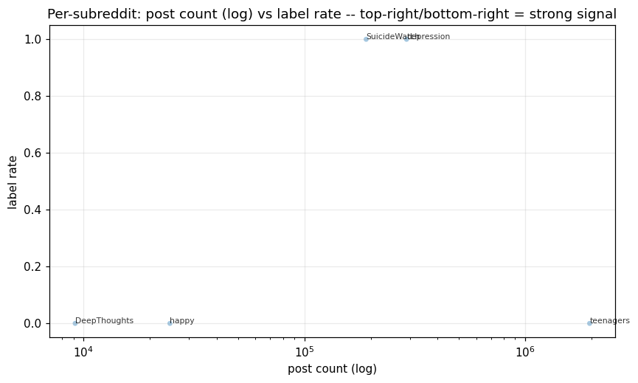
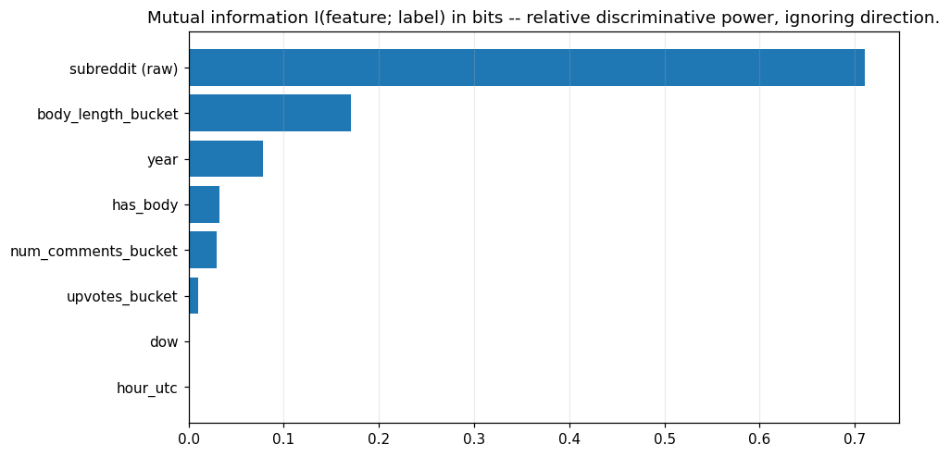
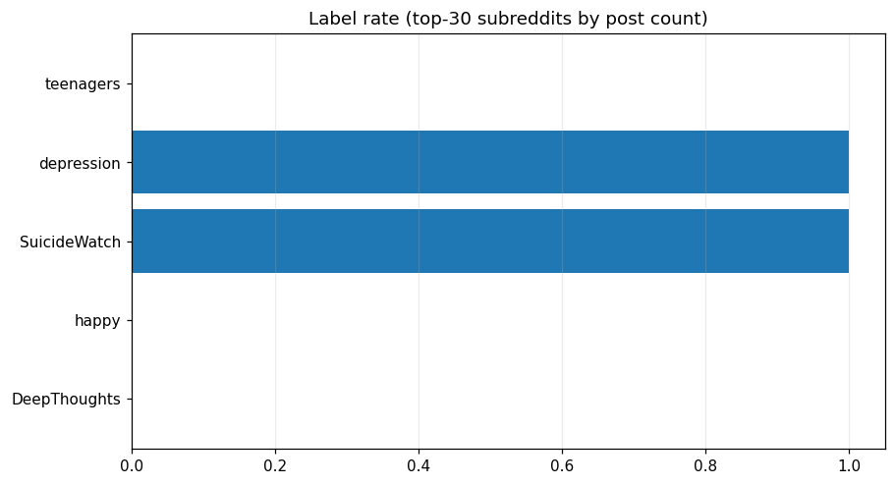

SUBREDDIT ≈ LABEL (DATA LEAKAGE)
Including subreddit = including the answer. Our reported metrics are subreddit-blind.

Slide 9
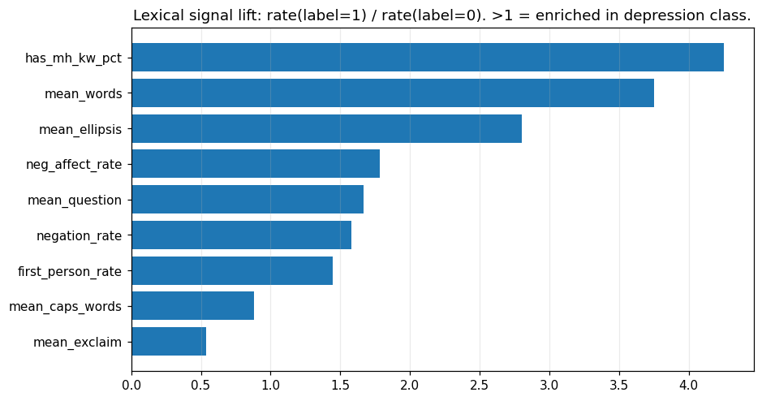
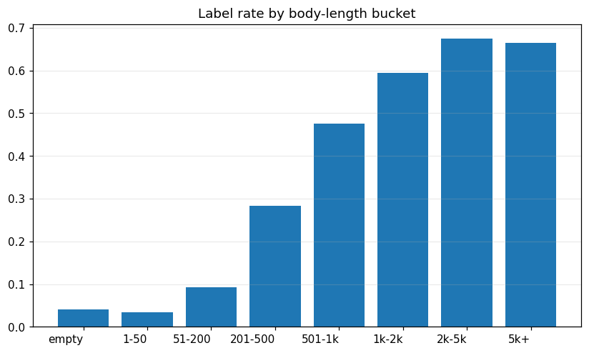

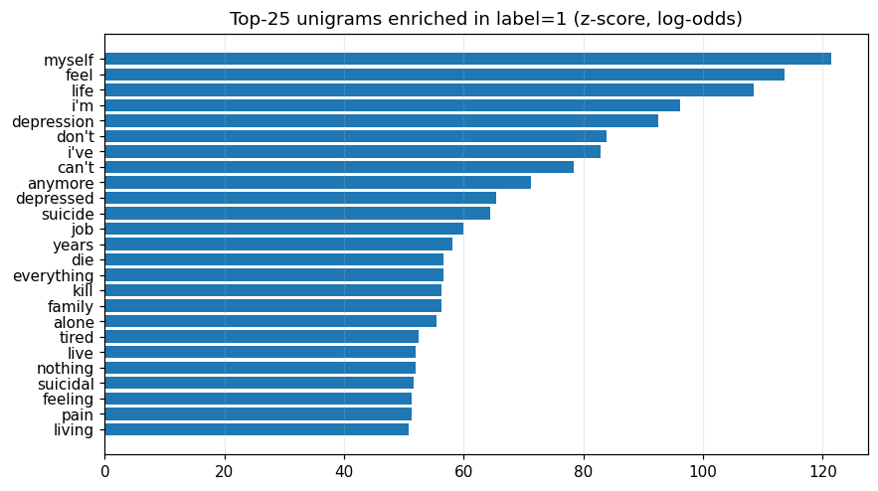
REAL TEXT SIGNALS EXIST BEYOND SUBREDDIT

Slide 10
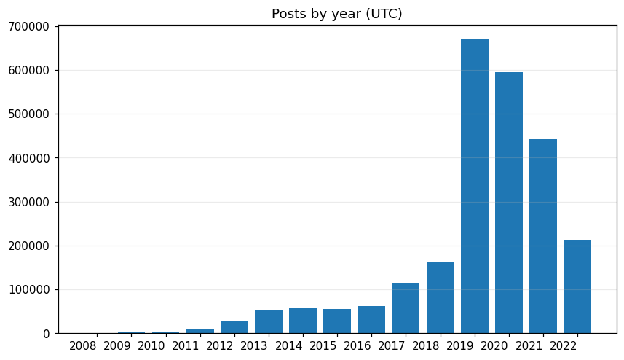

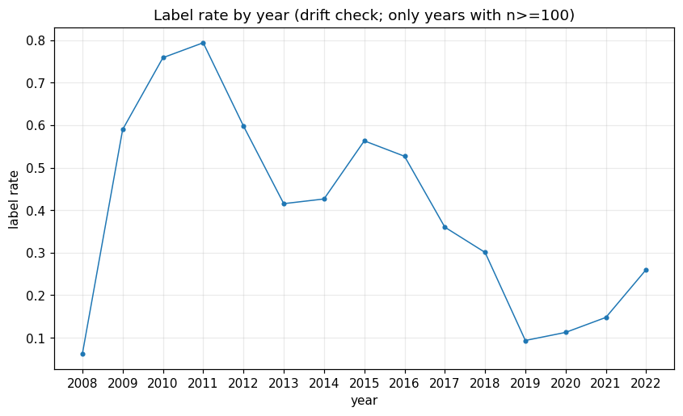

TEMPORAL DRIFT: WHY NOT RANDOM SPLIT?
Volume also shifts (peak 2019 = 27.1%) — composition changes, not just volume
Label rate swings wildly across years

Slide 11
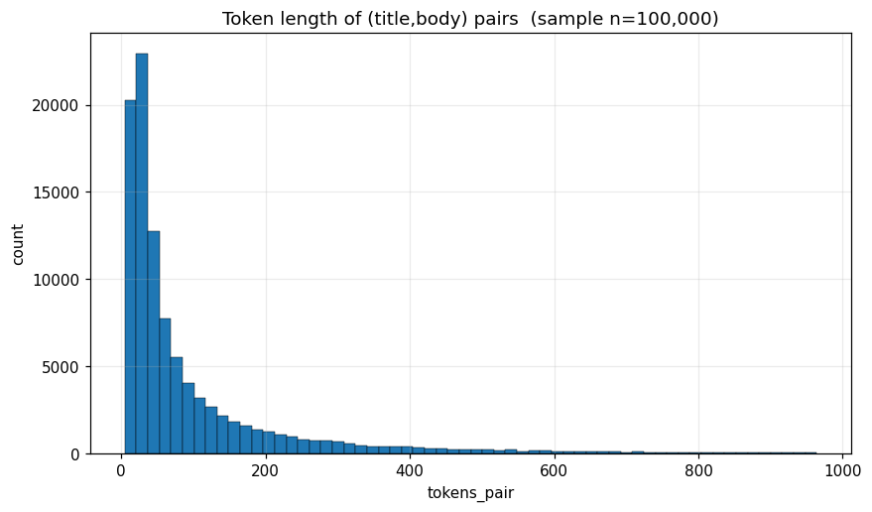

TOKEN LENGTH ANALYSIS & CHOOSING MAX_LENGTH
RoBERTa fixed window — choose max_length balancing coverage vs compute.
max_length=512 covers 96.6% of posts; head+tail truncation for the rest.

Slide 12
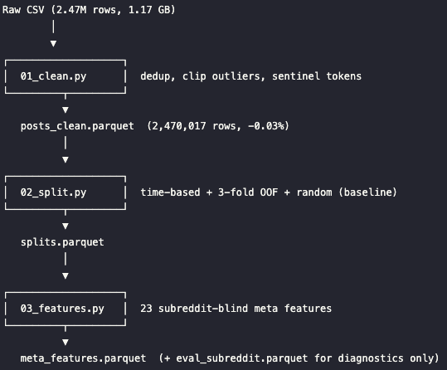
PREPROCESSING PIPELINE
Step 1 - Cleaning
Drop null label/id, dedup body, flag removed bodies
Clip upvotes & comments at p99.5
Replace [URL], [USER], [SUB] sentinel tokens
2,470,778 → 2,470,017 rows (0.03% dropped)
Step 2 - Splitting
Primary: time-based (train ≤2020 / val 2021 / test 2022)
OOF: 3-fold stratified on time-train (for Stage 2 stacking)
Baseline: random stratified 80/10/10 (comparison only)
Step 3 - Features
Build 38 metadata features (29 raw + 9 engineered) (length, lexical, engagement, temporal)
Subreddit-blind — subreddit saved separately for evaluation only

Slide 13

Stage 1 — MentalRoBERTa + LoRA
Backbone: mental/mental-roberta-base (domain-specific for mental health; fallback to roberta-base)
LoRA Configurations: r=16, target modules: query + value -> only ~0.47% trainable parameters (~590K)
Loss Function: BCE + pos_weight + label smoothing (0.05)
Imbalance Handling: 50% undersampling of negative samples on the training fold

Slide 14
Custom Classification Head
4-step head: layer-weighted avg (last 4 layers) → CLS + masked-mean pool → residual FFN → Multi-Sample Dropout (K=5).
Enhances generalization without full fine-tuning of ~125M backbone parameters.

Slide 15

Training Setup & OOF Stacking
Hardware: Kaggle 2× T4 GPUs, max_length=512, effective batch size = 64
Validation Strategy: 3-fold stratified OOF (Out-Of-Fold) on time-train -> prevents data leakage during Stage 2 stacking
Primary Metric: F1-macro
Evaluation: Subset of 60K (for early stopping) + full validation set of 605K (for OOF predictions)

Slide 16
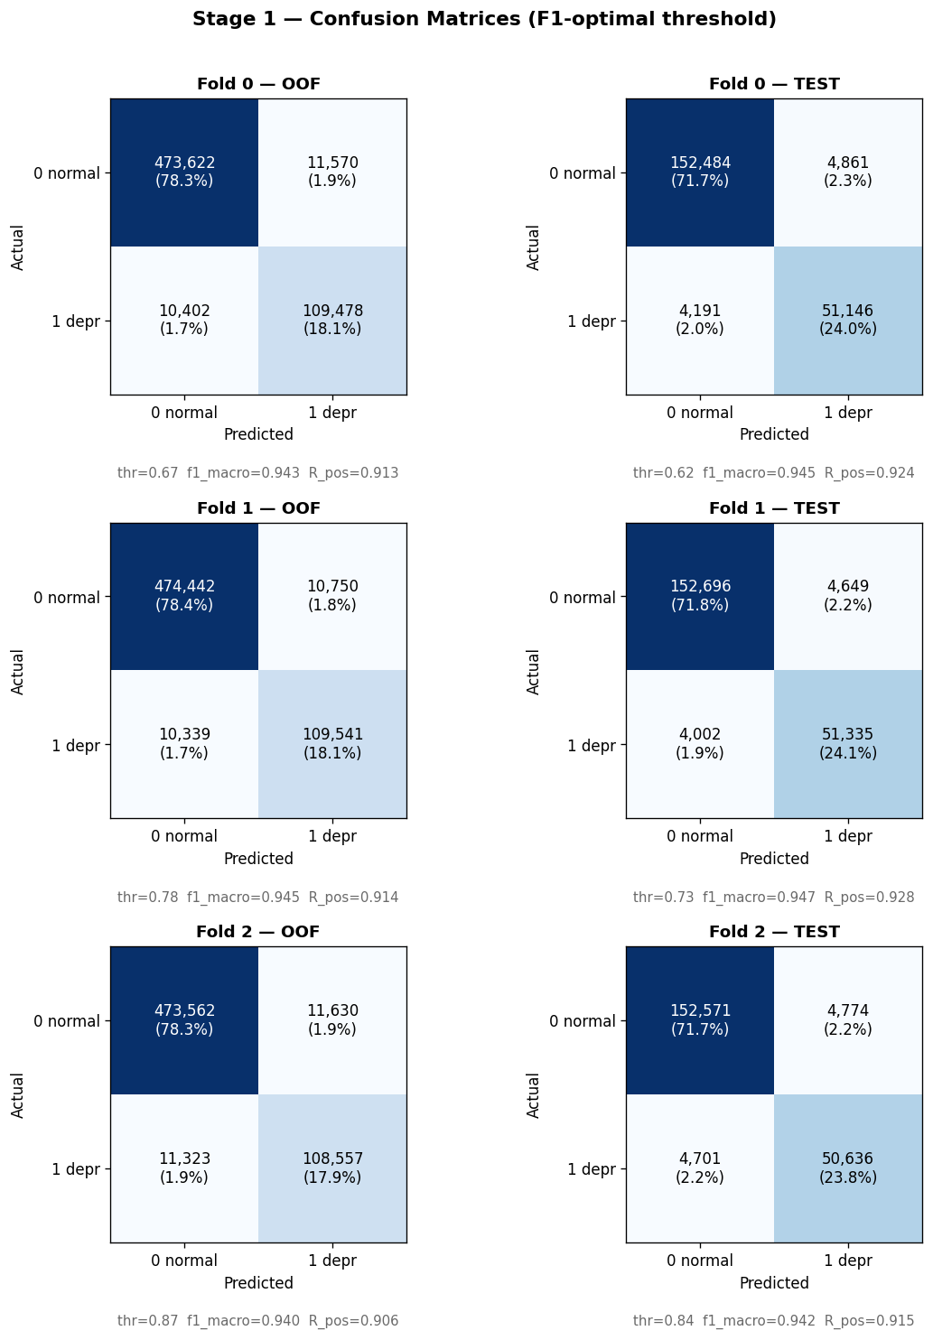
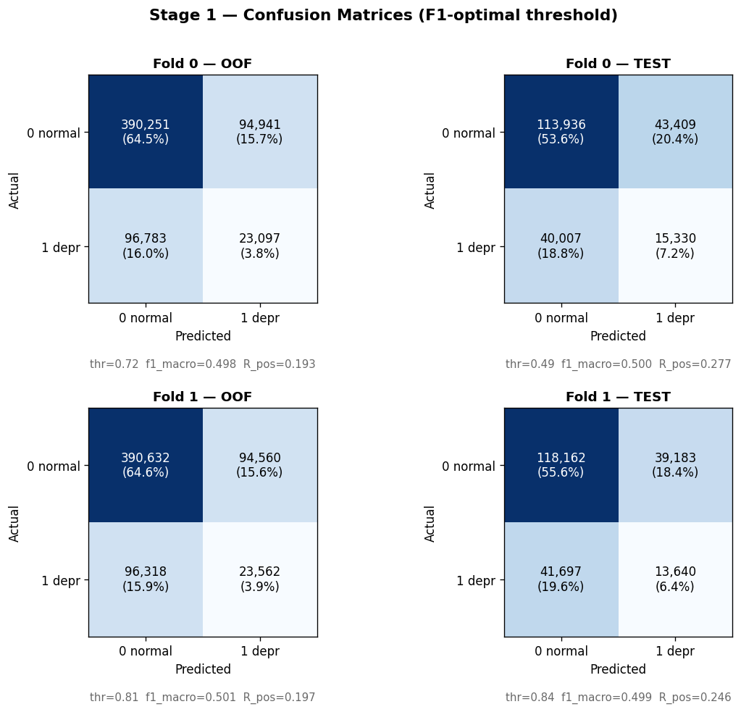
Stage 1 Results — Per-fold OOF & TEST
Per-fold @best-f1 (verified predictions):
F0 OOF thr=0.69 f1=0.943 R_pos=0.910 | F0 TEST thr=0.62 f1=0.945 R_pos=0.925
F1 OOF thr=0.77 f1=0.945 R_pos=0.918 | F1 TEST thr=0.73 f1=0.947 R_pos=0.929
F2 OOF thr=0.87 f1=0.940 R_pos=0.906 | F2 TEST thr=0.84 f1=0.942 R_pos=0.915
~6.4 h/fold Kaggle 2×T4 | Primary metric: F1-macro

Slide 17
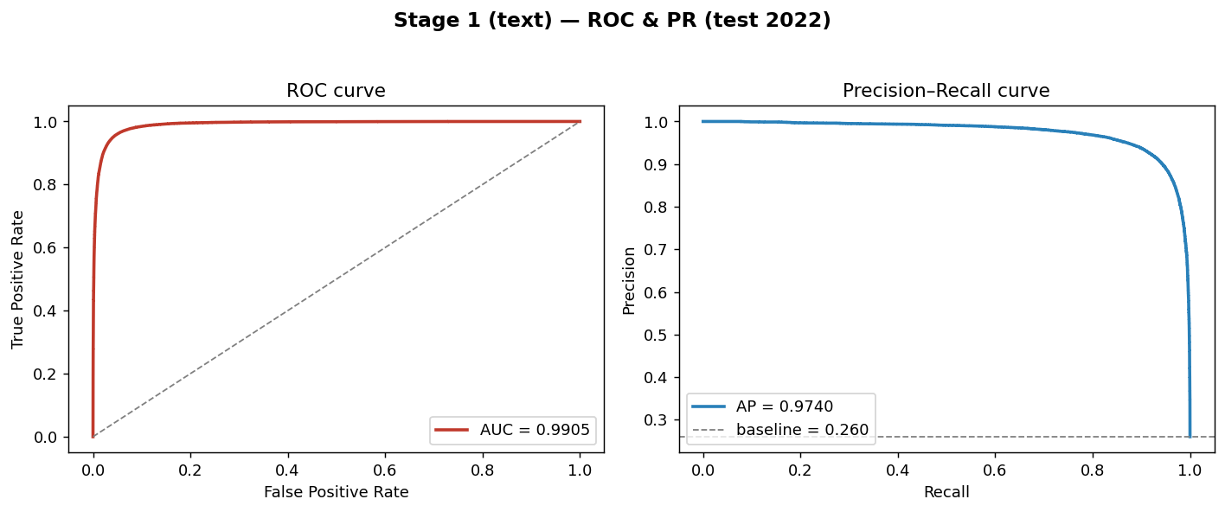
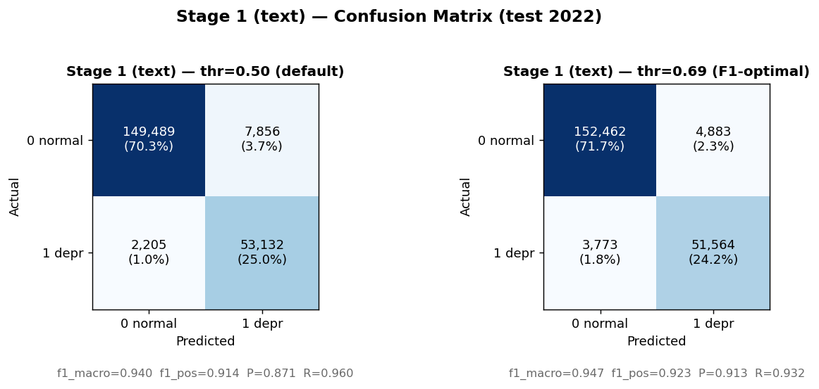
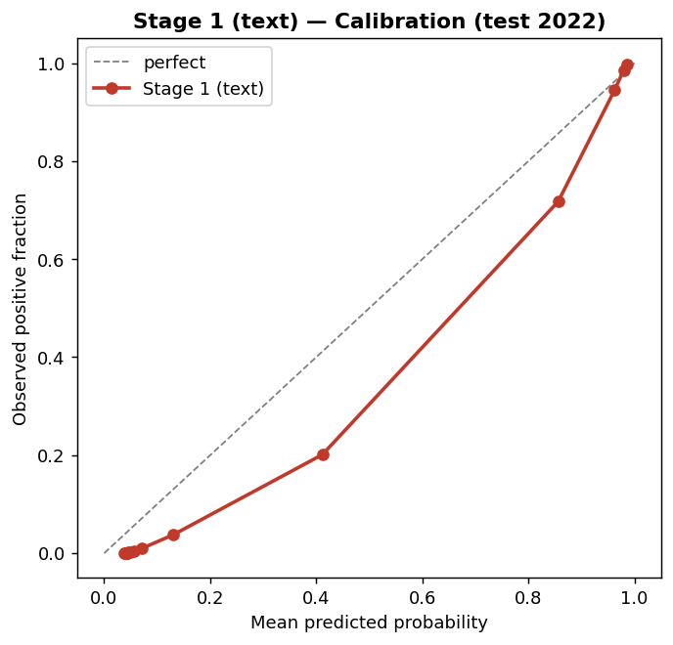

Stage 1 — TEST 2022 Ensemble Metrics

Slide 18
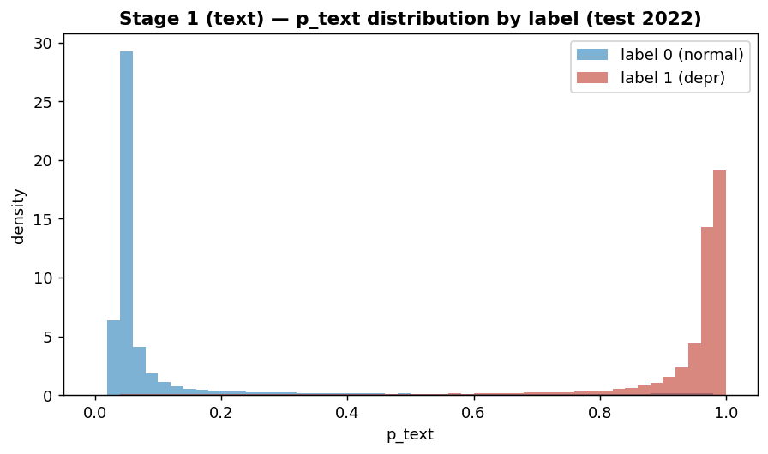



Stage 1 — Calibration & Score Distribution

Slide 19

STAGE 2 FEATURE SET (SUBREDDIT-BLIND)
Stage 2 LightGBM: 39 inputs = p_text + 38 metadata (29 raw + 9 engineered).
Rule: computable from one post alone — no subreddit, year, or subreddit-percentile proxies.
Raw: length, engagement, lexical counts, temporal cyclical, booleans.
Engineered: length-normalized rates (first_person_rate, negative_word_rate, …).

Slide 20


Stage 2 — Model & Tuning
Input: p_text (OOF) + 38 metadata (29 raw + 9 engineered) = 39 features
Ablation: A=text only | B=meta only | C=full ensemble (production)
Tuning: Optuna 50 trials, class_weight='balanced'
Stacking on OOF p_text prevents leakage

Slide 21
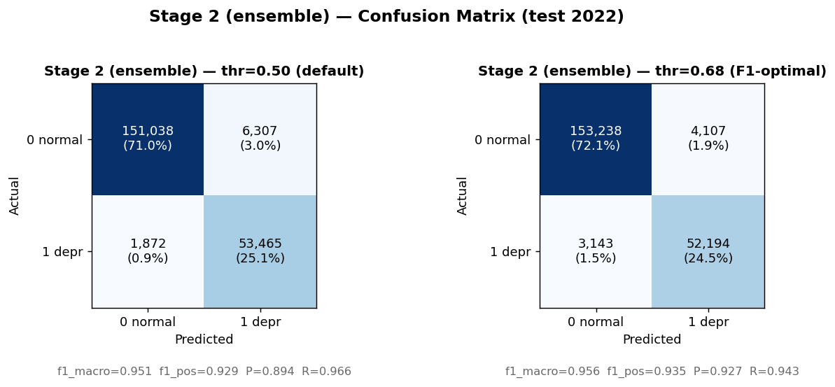

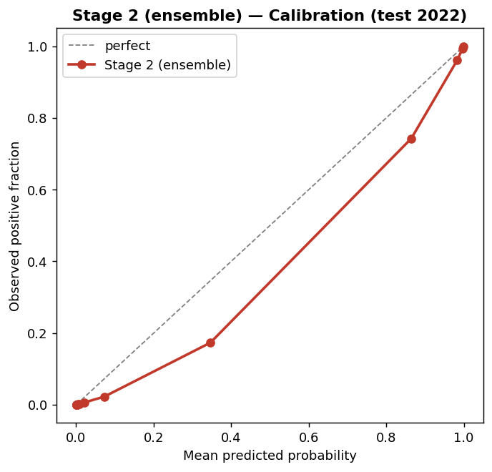
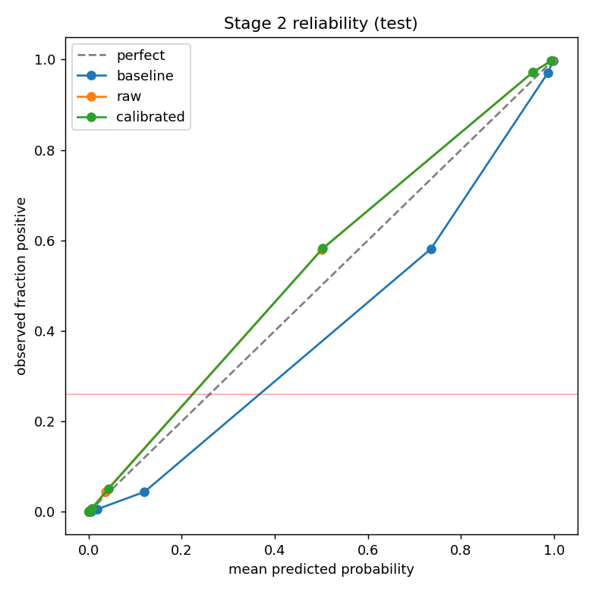
Stage 2 — Calibration & Confusion (TEST 2022)
Calibration: baseline over-confident (mean_p≈0.29 vs base 0.26). Surveyed Platt/isotonic; kept baseline to prioritize positive recall.

Slide 22
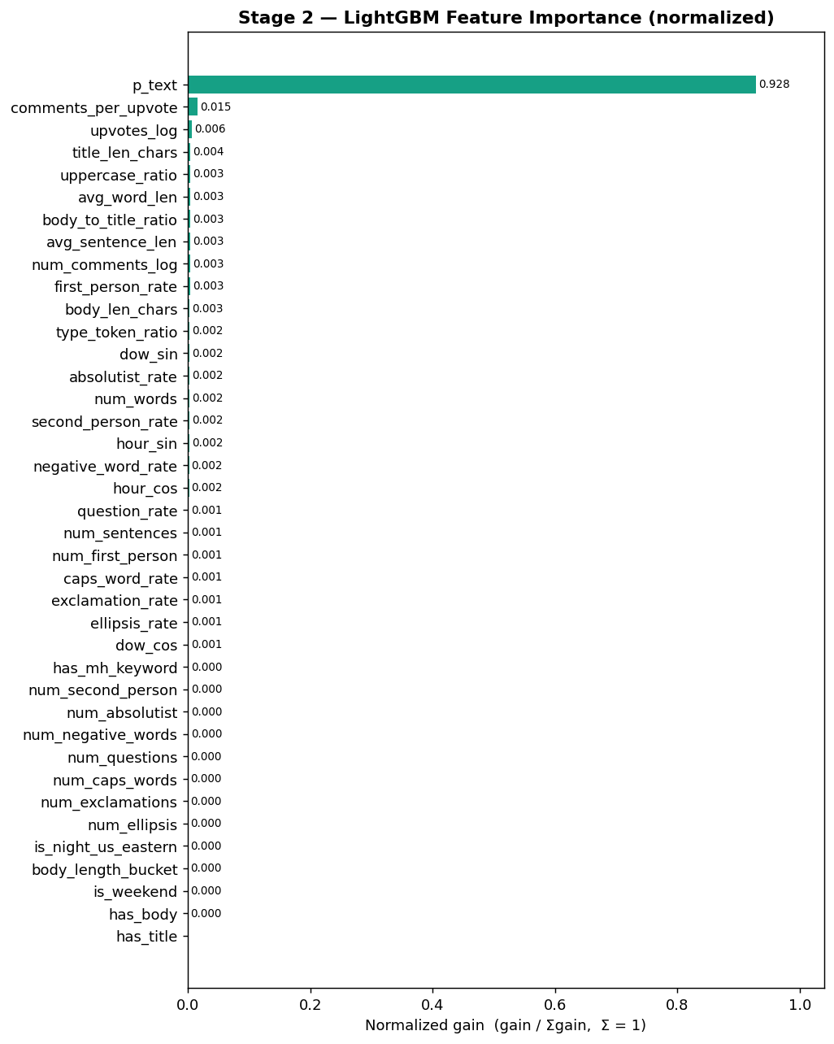
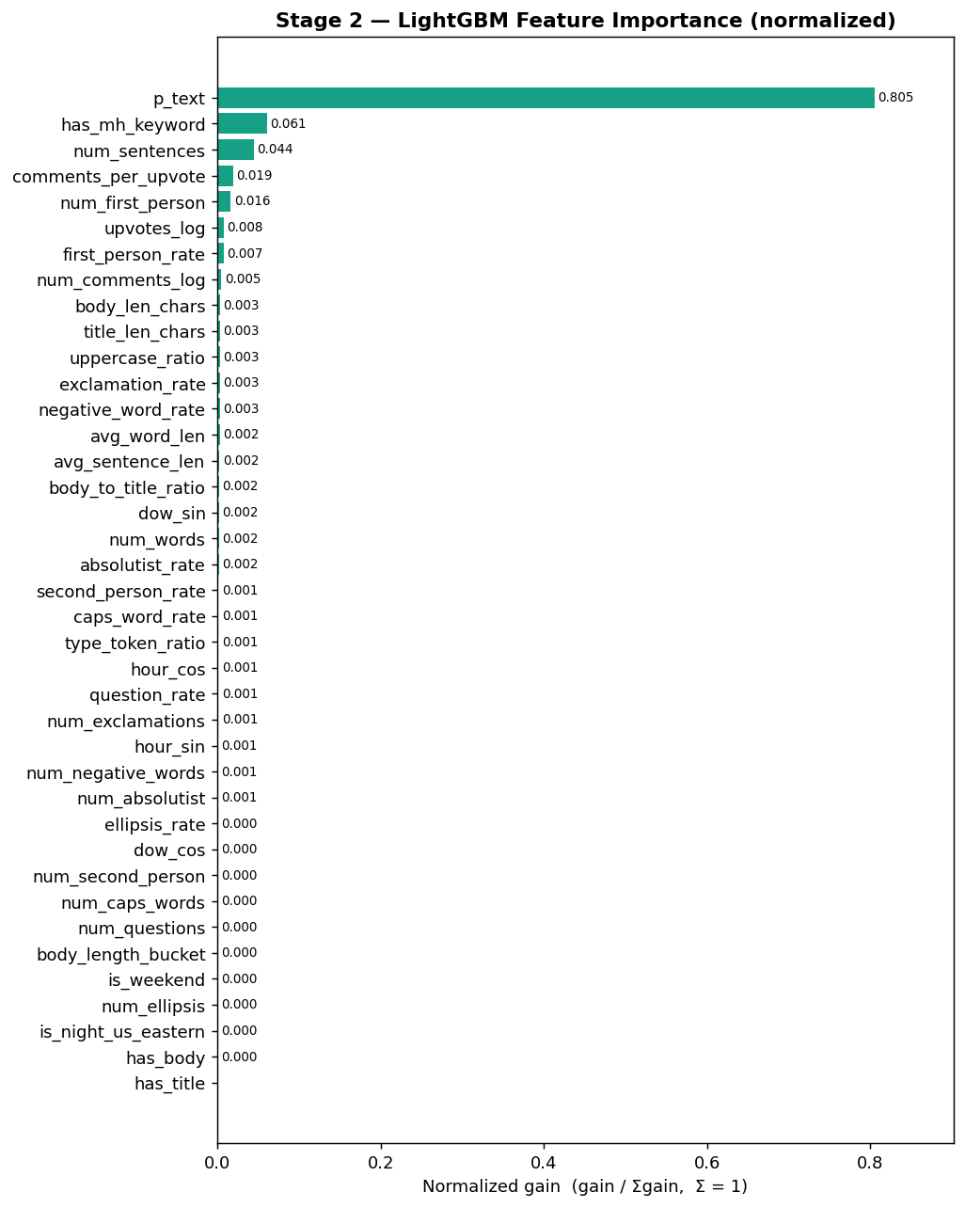
Stage 2 — Feature Importance

Slide 23
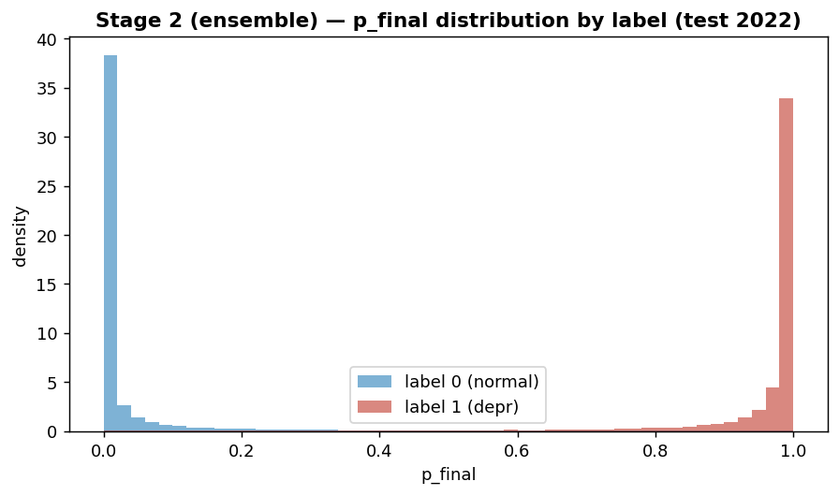

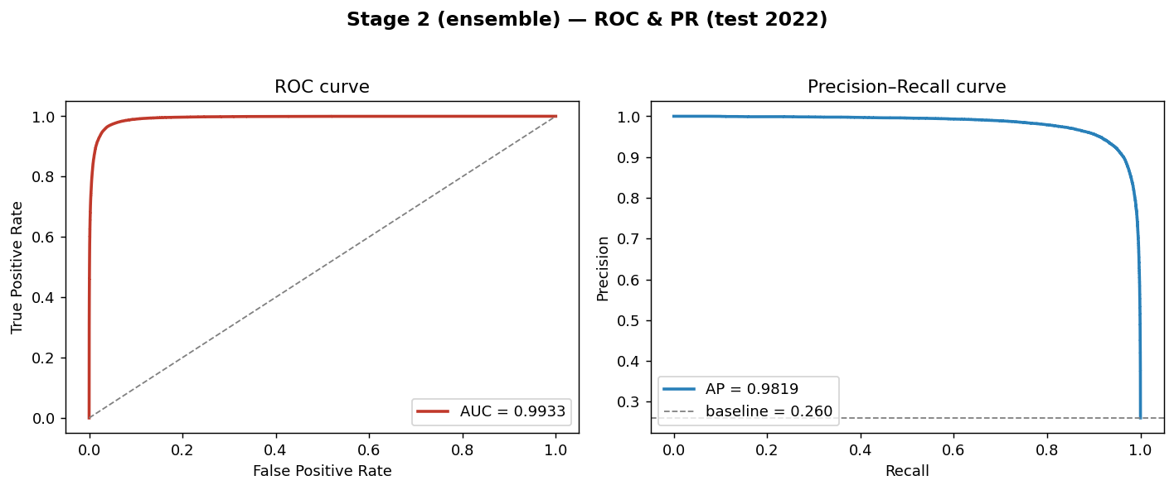

Stage 2 — ROC / PR & p_final Distribution

Slide 24
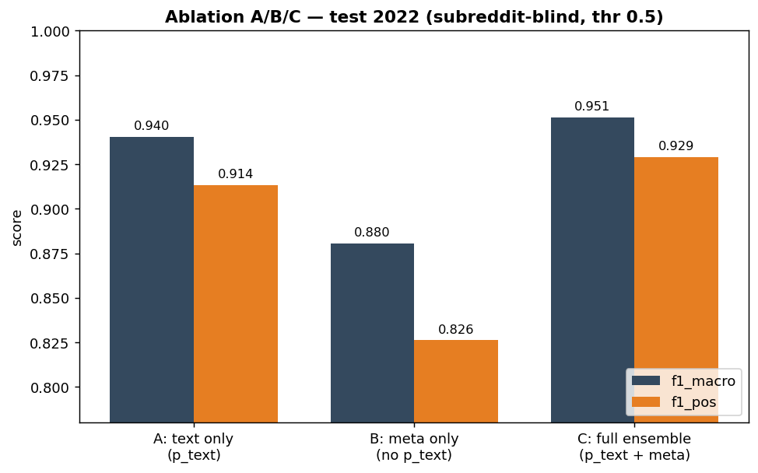

Ablation Study A/B/C
Ablation TEST 2022 (subreddit-blind, thr=0.50):
A text-only: f1_macro=0.940, f1_pos=0.914
B meta-only: f1_macro=0.881, f1_pos=0.826
C full ensemble: f1_macro=0.951, f1_pos=0.929, recall_pos=0.966

Slide 25






Summary & Future Work
Completed
Future Work
Open Orientation
Completed: EDA + preprocessing; Stage 1 + Stage 2 trained & evaluated on TEST 2022; ablation A/B/C; live inference app (FB/Threads/Reddit, VI→EN, domain-mismatch handling).
Future: Platt/isotonic calibration, cross-lingual models, dataset balancing, cross-subreddit holdout.
In the future, it is possible to deploy Platt Scaling to calibrate probabilities, study cross-lingual models, and better balance data sets.
Notes:
To summarize, the completed parts are EDA, preprocessing, time-based splitting, leakage audit, and Stage 1 training.
The key lesson from the EDA is that high performance can be misleading if the model is allowed to use subreddit information. That is why the modeling pipeline is designed to be subreddit-blind.
The next steps are to assemble out-of-fold p_text predictions, train LightGBM, evaluate once on the 2022 test set, and run final error analysis.
For future extensions, we can improve probability calibration using Platt scaling, test cross-lingual robustness, and collect a more balanced dataset where labels are less tied to subreddit membership.

Slide 26
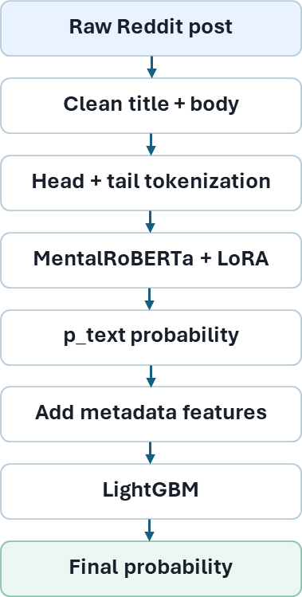
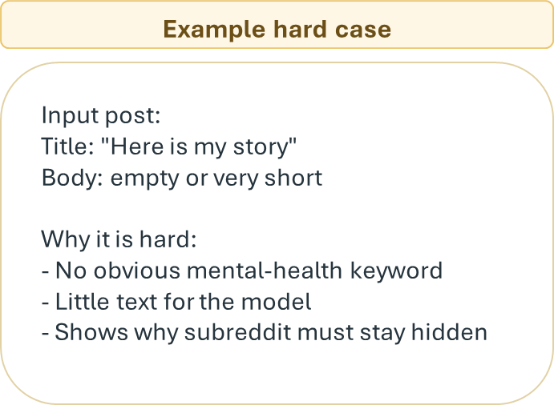
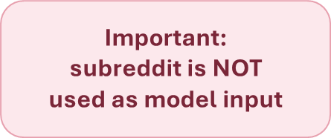
Demo — Live Inference App
Live inference app (ver2/app) — FastAPI + web UI
• Scrape Reddit/Facebook/Threads URL or paste text + engagement metadata
• Optional VI→EN translation → Stage 1 p_text → Stage 2 p_final
• Non-Reddit posts: neutralize Reddit-specific meta features (domain-mismatch)
• Production: full_trainable.safetensors + stage2_lgbm.pkl
Notes:
This final slide shows how inference works for one Reddit post.
On the left is an example hard case. The title is very short, and the body may be empty or contain very little information. There may be no obvious mental-health keyword.
This type of case is difficult because a simple keyword-based model may fail. It also shows why we must not use subreddit as an input.
On the right is the inference pipeline. First, we take the raw Reddit post. Then we clean the title and body. Next, we apply head-and-tail tokenization and send the text to MentalRoBERTa with LoRA.
The text model outputs p_text, which is the text-based probability. Then we add post-level metadata features such as body length, engagement, and posting time.
Finally, LightGBM produces the final probability.
The most important point is that subreddit is not used as model input. It is only used later for diagnostic analysis.
That concludes my presentation. Thank you for listening. I am ready for questions.

Slide 27
THANK YOU !

